Slide 1
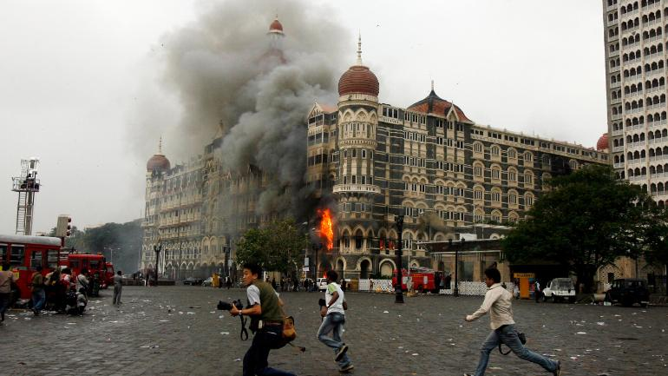

Analysing and Classifying Global Terrorism Using Machine Learning and Statistical Techniques
For the fulfilment of
Master of Science in Applied Statistics and Analytics
Submitted By
Biswajit Mandal
Dept. of Applied Statistics and Analytics, MAKAUT
Supervised By
Mr. Prasenjit Banerjee

Slide 2

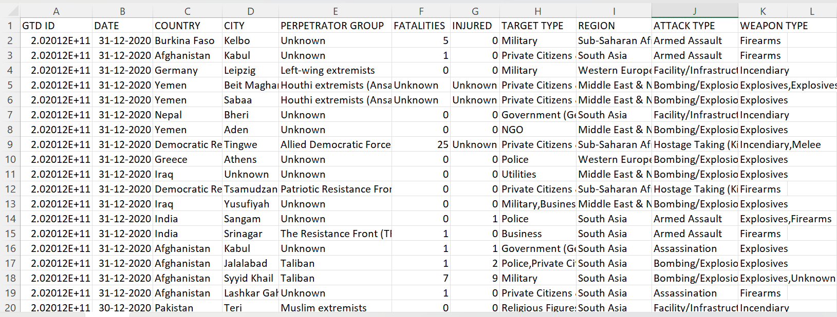
Collection of Data
All the datasets are collected from the excellent digital initiative of University of Maryland and START (National Consortium for the Study of Terrorism and Responses to Terrorism), Global Terrorism Database (GTD) which maintains more than 200k records for the years 1970 to 2020.
The dataset containing of 17 variables like suicide, attacktype, nter, claimed, weapontype, extended, nkilled, nkilledter, nwounded, nwoundedter etc. Some samples of the dataset are shown below -

Slide 3
Objective:
To look upon few data visuals to get an overview of the current scenario of the attack frequencies done by different terrorist groups. Also, to get an idea about the spatial regions and intensity of terrorist attacks around the globe.
To Classify a ‘terrorist attack’ based on certain covariates and to predict the most probable group for the attack.

Slide 4
Data Preprocessing
Handling missing values.
There were 217 missing values in total and all of them were in categorical valuables. We replaced missing observations and unknown observations as a category.
Data normalization.
We checked out for the outliers and we trimmed them out of the dataset.
Splitting data into training and testing sets.
Then we split the dataset in 80% for Training and 20% for testing.

Slide 5
Visualization of Data
In this section, at first we will look into the frequency distribution of the terrorist groups according to the number of attacks. We have considered data from 1970 till 2020.
Groups with No. of Attacks | Frequency
5-500 | 1713
500-1000 | 12
1000-2000 | 10
2000-5000 | 6
>5000 | 1
Now, from some frequency distribution of different classes with predefined attack frequencies, we can visualize the distribution of number of terrorist attacks and terrorist groups.

Slide 6
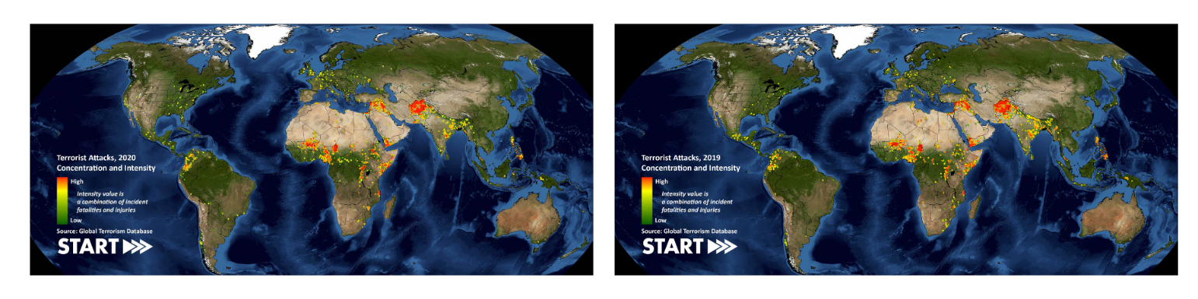
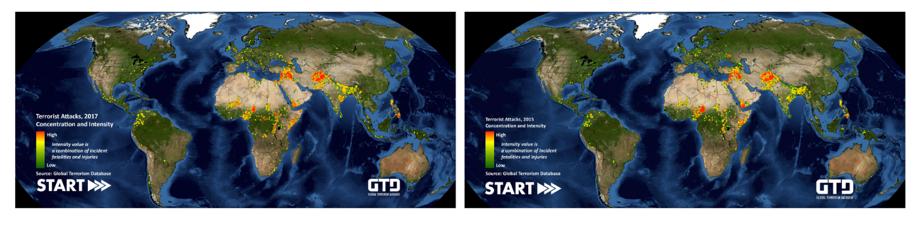
In those below maps the intensities of the terror attacks are categorized from low to high based on the number of casualties and degree of property losses. According to the diagrams below, we can see that some of the main terrorist attack prone areas are Central Asia, Middle East and some parts of Africa.
From the above figures, it is observed that Middle East and Central & North-eastern parts of Africa also shows significant increase in the number of terrorist attacks. According to the shown patterns, one can expect more growth in the numbers at the specific regions in the near future.

Slide 7
In this figure, it is shown that, the top five targets of terror attacks were Citizens (29.2%), Military (20.1%), Police (13.9%), Governments (8.3%) and Businesses (7.3%). Hence, we can comment that at the present time, the protection on these 5 sections, especially on Citizens and Militaries should be strengthened more.

Slide 8
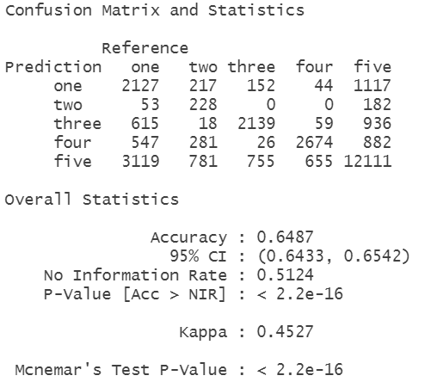
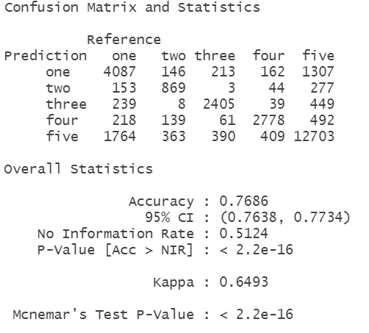
Classification of Terrorist Attacks
We have applied Three different classification techniques to classify Terrorist Attacks. Those are Decision Tree, Random Forest and Bagging. Results are given below -
Decision Tree:
Random Forest:
From the output, it is seen that the model is 64.87% accurate, i.e., we can tell that Decision tree is an average classifier for our purpose. [Accuracy=Sum of diagonal of the confusion matrix/Sum of its all elements].
The accuracy of the model is equal to 76.86%, i.e., it is much higher than a Decision Tree model which was quite expected, as RF is a group of Decision trees (ensemble).

Slide 9
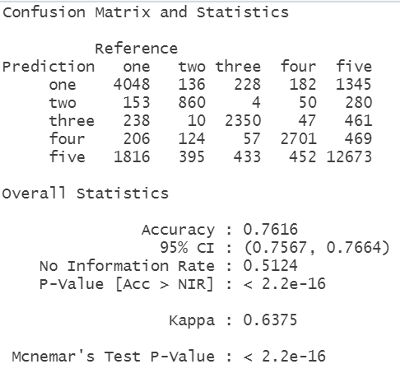
Bagging:
We can see that the model of Bagging is also performing quite well in the testing data. Accuracy of the model = 76.16% which is moderately good.

Slide 10
AIMS
To look upon few data visuals to get an overview of the current scenario of the attack frequencies done by different terrorist groups. Also, to get an idea about the spatial regions and intensity of terrorist attacks around the globe.
Classifying a ‘terrorist attack’ based on certain covariates and to predict the most probable group for the attack.
FINDINGS
In the Data Visualisation section we have figured out groups with most attack frequencies, then we figured out groups with no. of attacks and their frequencies. Then we have seen most attack prone jone around the globe.
We have seen that Random Forest has given the best accuracy in the prediction of the testing set, hence we would choose for Random Forest among the 3 applied classification models.
FUTURE SCOPE
In future we can do Near-Repeat analysis which is also quite useful if we want to predict the probabilities and expected frequencies of ‘Near-Repeat’ attacks at a certain place and at a certain time.

Slide 11
References
Data visualization – START - Global Terrorism Database
Quantitative Analysis of Global Terrorist Attacks Based on the Global Terrorism Database Zhongbei Li, Xiangchun Li, Chen Dong, Fanfan Guo, Fan Zhang and Qi Zhang
GTD - CODEBOOK: METHODOLOGY, INCLUSION CRITERIA, AND VARIABLES
Near Repeat Calculator - https://figshare.com/articles/code/Near_Repeat_Calculator/11409996
Blog – Near Repeat Analysis - https://www.jratcliffe.net/near-repeat-analysis
Xiaohui Pan - Quantitative Analysis and Prediction of Global Terrorist Attacks Based on Machine Learning
Olusola A. Olabanjo, Et. Al. - An ensemble machine learning model for the prediction of danger zones: Towards a global counter-terrorism
Kanika Singh, Et. Al. - A Machine Learning Approach for Enhancing Defence Against Global Terrorism.
"Pattern Recognition and Machine Learning" by Christopher M. Bishop
"Classification and Regression Trees" by Leo Breiman, Jerome Friedman, Charles J. Stone, and R.A. Olshen

Slide 12
FINI….
BYE EVERYONE !!!

